Slide 1
NorthBound Infrastructure Proposal on Centralised Management Daemon (CMGD)
Pushpasis Sarkar <spushpasis@vmware.com>

Slide 2
Current NorthBound(NB) Infrastructure
Problems with it
Performance impact on individual daemons
Loading huge configuration data.
Retrieving huge operational data.
Direct IPC between CLI client and FRR daemons
Too many internal IPC channels with other forms of UI
Running DB maintained inside individual daemons
Collection of ‘show running-configuration’ over multiple IPC channels.
Possible ordering issues with transaction-based configuration commits leading to inconsistent state.
Burden of YANG data parsing and validations on backend daemons.

Slide 3
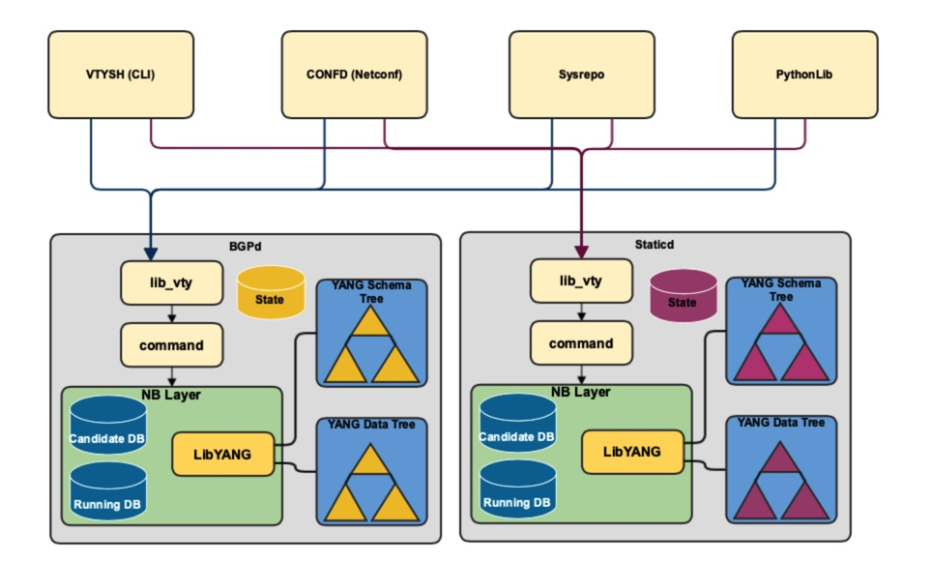
Current Architecture
Running DB and YANG trees maintained across all back-end daemons.
Harder to maintain consistency of configuration state across the system.
Bulk of UI processing borne by back-end daemons.
Keeping away from attending to other regular businesses.
Performance impact while
Commit large configuration or
Retrieving large operational dataset(s).
Full-Mesh’ of IPC connections between UI Front-end(s) and Back-end daemons.

Slide 4
Objectives of this Proposal
Consolidation and management of Running DB by a single entity
Better control over configuration validation, commit and rollback.
Faster collection of ‘show running-config’.
Remove burden of YANG data parsing and validations (model-wise) away from Backend daemons.
Improve performance and avoid CPU hogging of Backend daemons while:
Loading huge configuration changeset(s).
Retrieving huge operational dataset(s).
Avoid too many IPC channels between UI client and FRR daemons
Move from ‘Full Mesh’ to ‘Hub-n-Spoke’

Slide 5
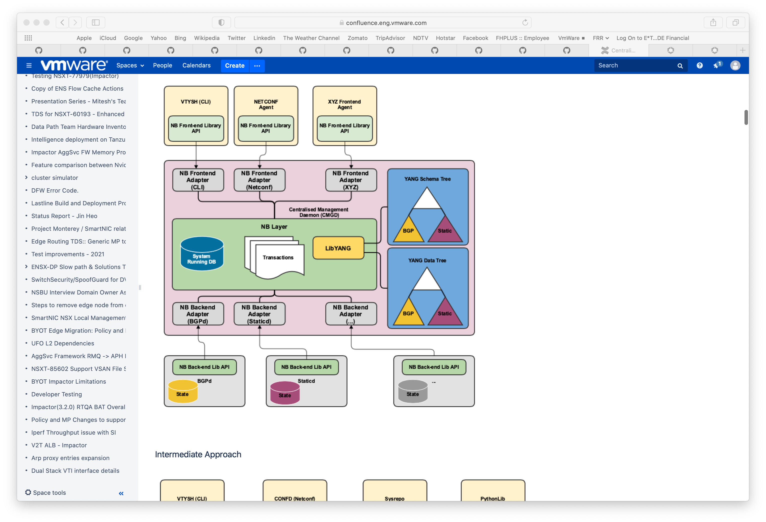
Centralized Management Daemon (CMGD)
Final Proposed Architecture
New CMGD daemon between UI front-end and Backend daemons.
Hub-n-Spoke instead of ‘Full-Mesh’
System-wide Running DB and all the YANG trees maintained by a single entity
Single point to manage and authenticate all UI transactions.
Minimal UI processing on the backend daemons.

Slide 6
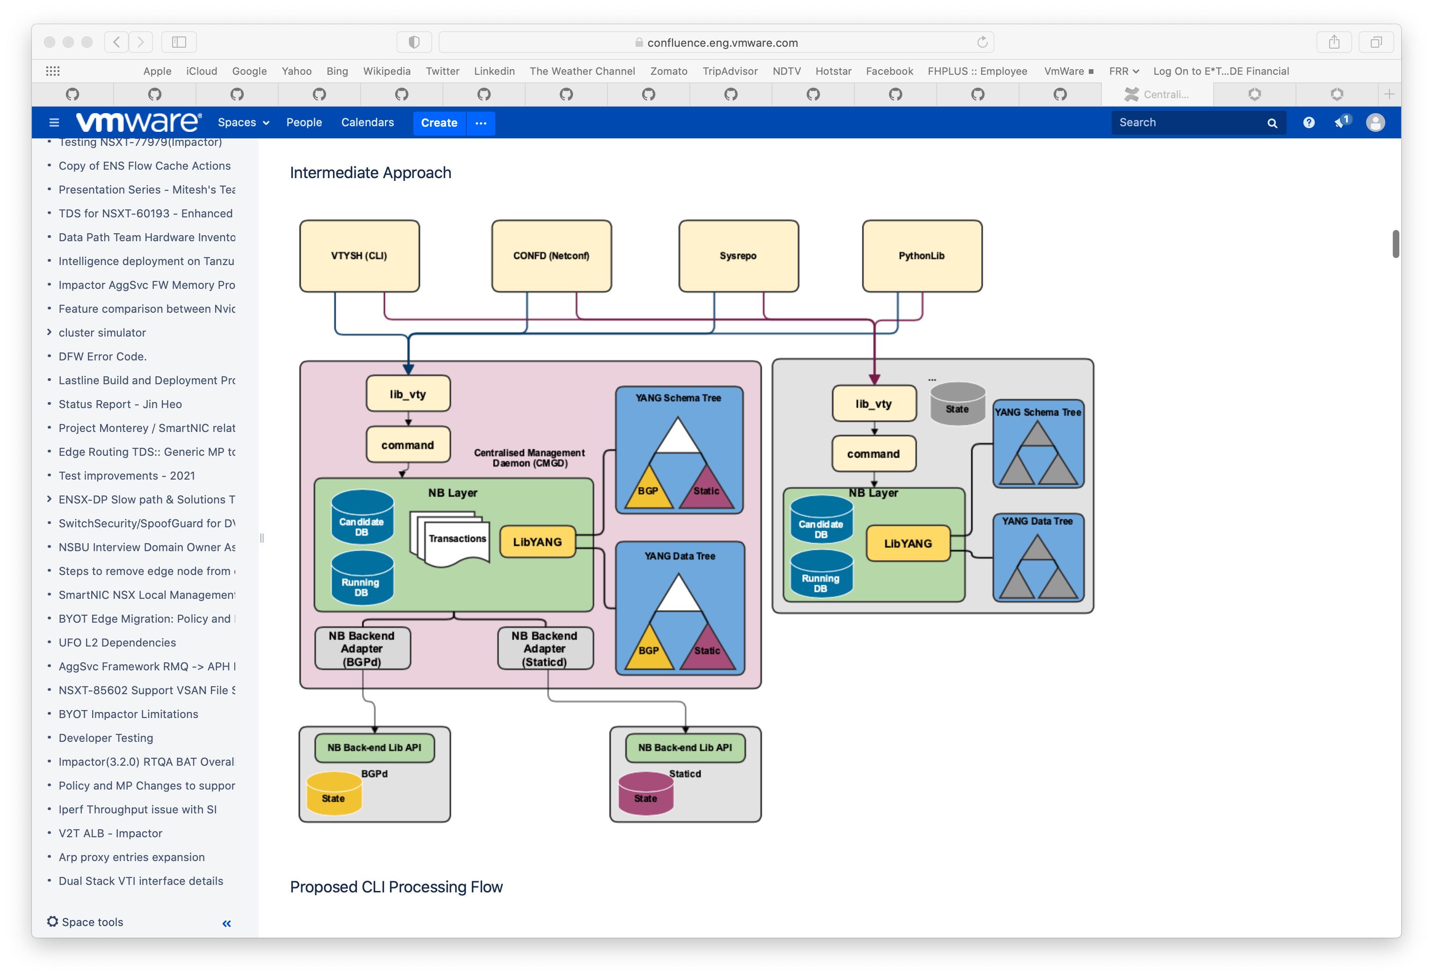
Centralized Management Daemon (CMGD)
Interim Proposed Architecture
New and old infrastructure co-exist together.
Minimal impact.
Upgrade backend daemons one by one and move to new infrastructure.
Remove old infrastructure after all backend daemons has been moved to new infrastructure.
Revamp existing or implement new front-ends using the new infrastructure.

Slide 7
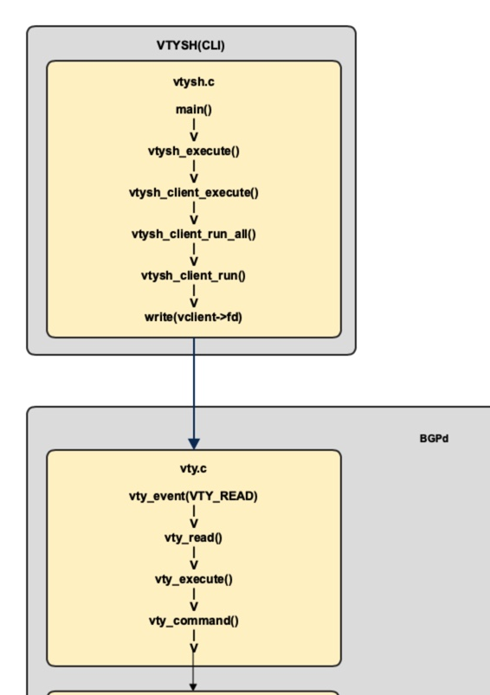
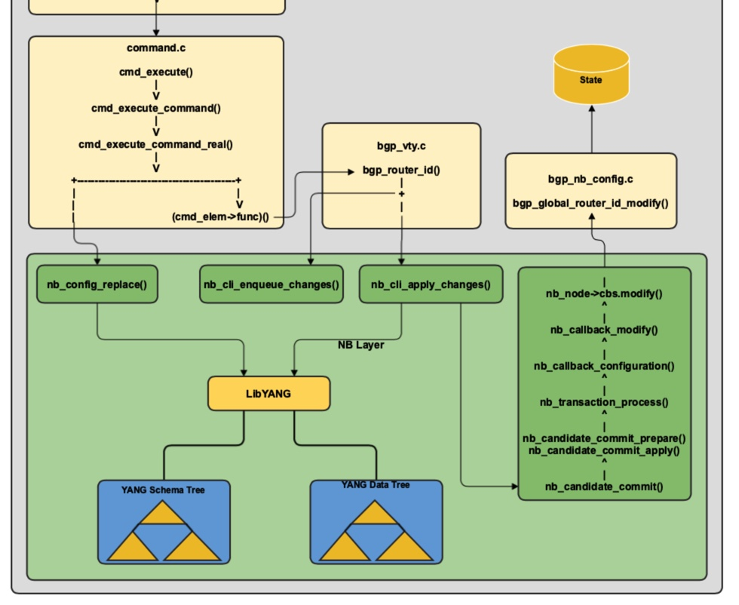
Current CLI Processing Flow

Slide 8
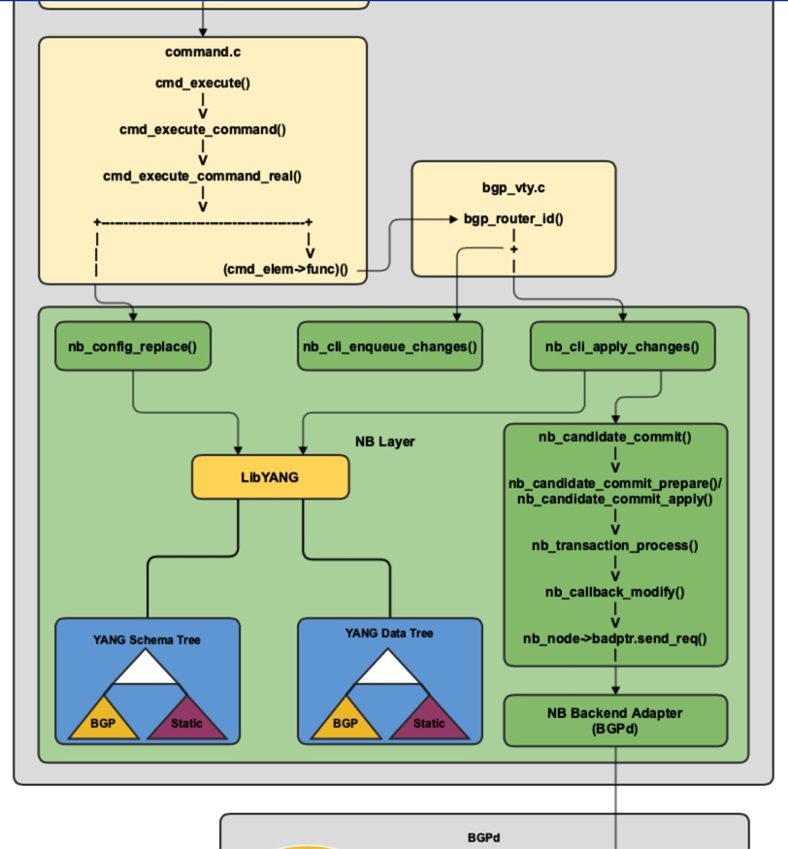
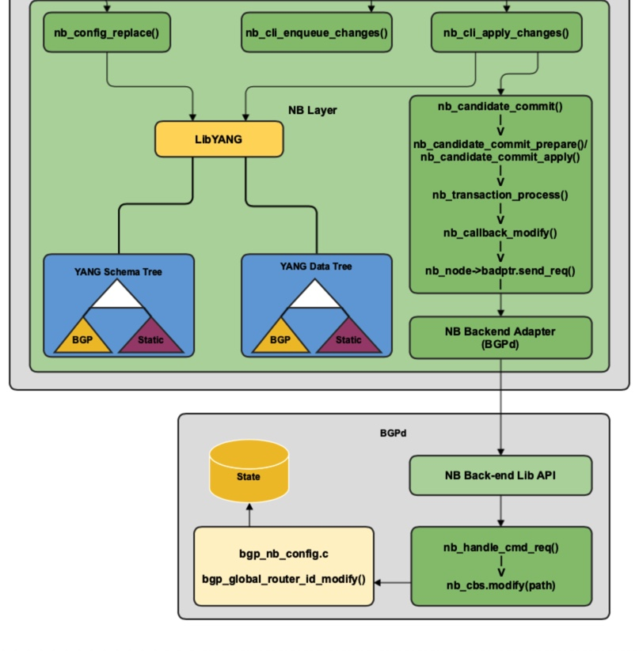
Proposed CLI Processing Flow

Slide 9
Datastore Model

Slide 10
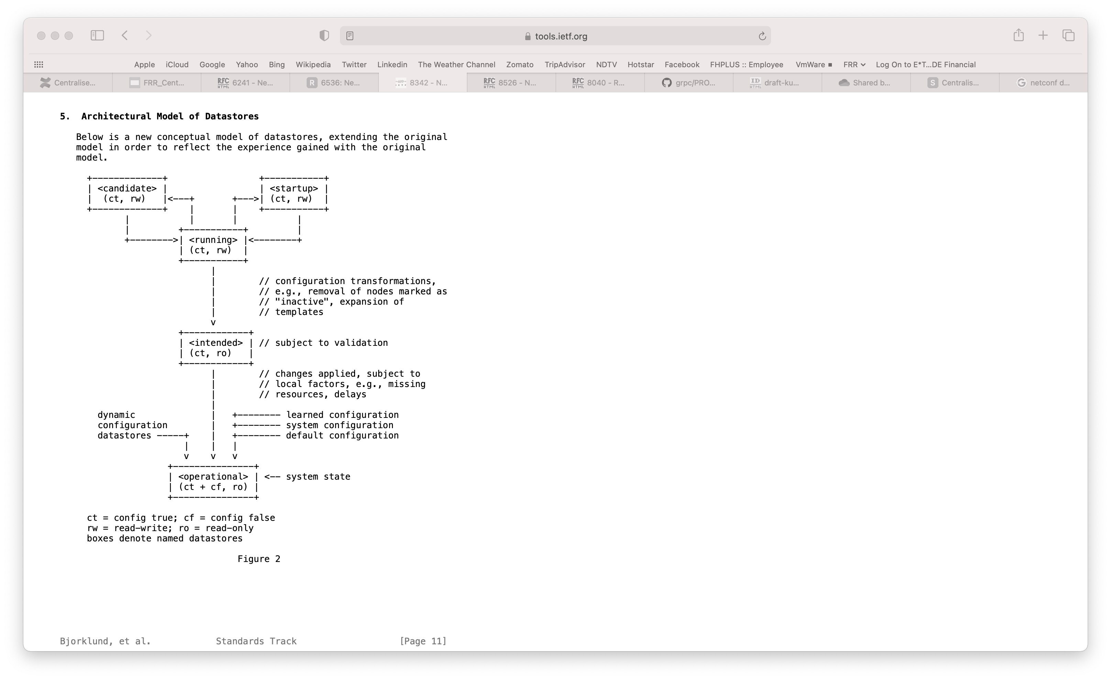
Datastore Model
NETCONF RFC8342

Slide 11
Datastores Requirements
Types of Datastores
Config Datastores/DBs
NETCONF RFC6536
Running DB
Global – SUPPORT: YES
Candidate DB
Global – SUPPORT: YES
Per-Session –Not needed
Startup DB
Global – SUPPORT: YES
Intended DB -- Global
Should it be Supported?
Others
Multiple copies for Rollback???
Operational Datastores/DB
Both Config(config:true) and Operational(config:false) data.
WRITE operations NOT allowed.
READ always fetched from back-end.

Slide 12
Front-End Interface

Slide 13
Front-End Clients
CLI Terminal / VTYSH
NETCONF (RFC6241) Agent
RESTCONF (RFC8040) Agent
GRPC (grpc.io) Agent

Slide 14
Front-End Clients
NETCONF Requirements (RFC6241/RFC6536/RFC8526)
Datastores/DBs
Running DB <Global>
Candidate DB <Global>
Startup DB <Global>
Intended DB <Global> ???
Features
Writable Running
Candidate Configuration
Rollback-on-error
Validate
Distinct Startup DB
Operational Default
Operations
Base (RFC6241)
<lock>
<unlock>
<get-config>
<edit-config>
<delete-config>
<copy-config>
<commit>
<get>
Others (RFC6241)
<validate> – dry-run for ‘candidate’
<commit> without <commit-confirmed>
<cancel-commit> – NOT Supported
RFC 8526
<get-data>
<edit-data>

Slide 15
Front-End Clients
NETCONF Capabilities
Capability | Requirement | Support
Writable-Running Capability [RFC6241 section8.2] | Allow direct write operations like <edit-config> and <copy-config> on ‘Running’ datastore as target. | YES
Candidate Configuration Capability [RFC6241 section 8.3] | Supports a candidate configuration datastore. Requires supporting <commit> and <discard-changes> operation along with other regular operations. | YES
Confirmed Commit Capability [RFC6241 section 8.4] | Support <commit> operation with <confirmed-commit>, <commit-timeout> and <persist> parameters. Support <cancel-commit> operation. | NO
Rollback-on-Error Capability [RFC6241 section 8.5] | Support the "rollback-on-error" value in the <error-option> parameter to the <edit-config> operation | YES

Slide 16
Front-End Clients
NETCONF Capabilities (contd.)
Capability | Requirement | Support
Validate Capability [RFC6241 section 8.6] | Support <validate> operation. Support <test-option> parameter for <edit-config> operation. | YES
Distinct Startup Capability [RFC6241 section 8.7] | Support separate running and startup configuration datastores | YES
URL Capability [RFC6241 section 8.8] | Ability to accept the <url> element in <source> and <target> parameters. | TBD
XPath Capability [RFC6241 section 8.9] | Supports the use of XPath expressions in the <filter> element. | YES
Yang Library Capability [RFC8526 section 2] | Advertise support for YANG library 1.1 | YES

Slide 17
Front-End Clients
NETCONF Capabilities (contd.)
Capability | Requirement | Support
“with-operational-defaults” Capability [RFC8526 section 3.1.1.2] | Support <with-defaults> parameter with <get-data> operation. | YES

Slide 18
Front-End Clients
RESTCONF Requirements (RFC8040)
Datastores/DBs
Running DB <Global>
Candidate DB <Global>
Operations
HEAD
Get key fields only.
GET
POST
Create -- Config
Invoke -- RPC
PUT
PATCH
DELETE
QUERY

Slide 19
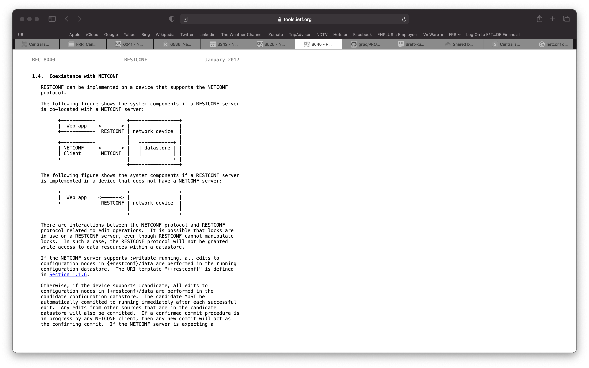
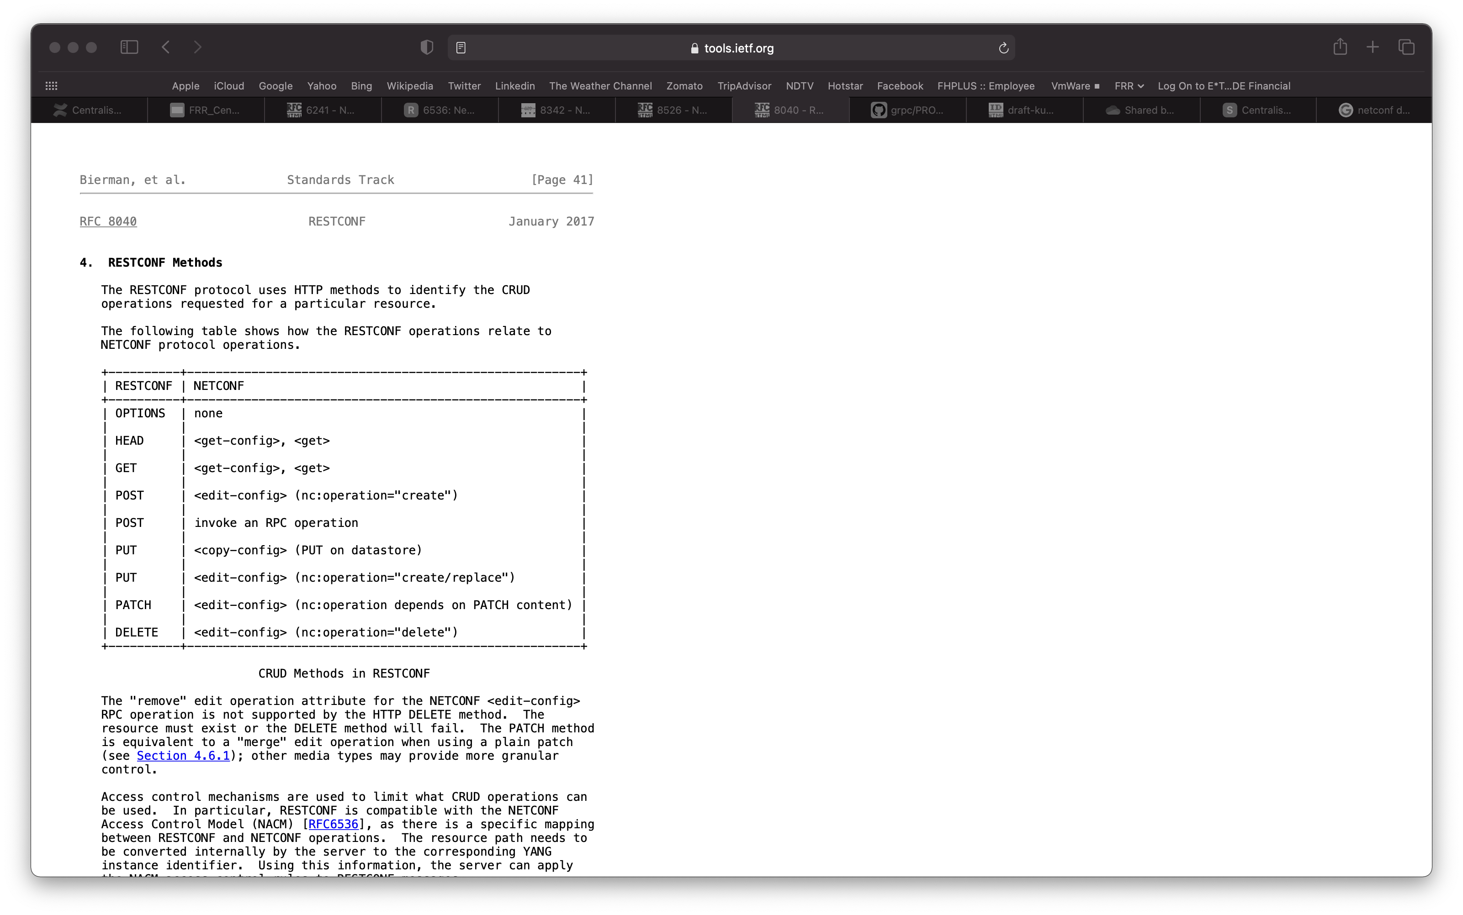
Front-End Clients
RESTCONF Requirements (RFC8040)

Slide 20
Front-End Interface
CMGD Front-End Adapter Message-API
INIT_SESSION_REQ<Client-Connection-Id>
INIT_SESSION_REPLY<Client-Connection-Id, Session-Id>
LOCK_DB_REQ <Session-Id, Database-Id>
LOCK_DB_REPLY <Session-Id, Database-Id>
UNLOCK_DB_REQ <Session-Id, Database-Id>
UNLOCK_DB_REPLY <Session-Id, Database-Id>
GET_CONFIG_REQ <Session-Id, Database-Id, Base-Yang-Xpath>
GET_CONFIG_REPLY <Session-Id, Database-Id, Base-Yang-Xpath, Yang-Data-Set>
SET_CONFIG_REQ <Session-Id, Database-Id, Base-Yang-Xpath, Delete>
SET_CONFIG_REPLY <Session-Id, Database-id, Base-Yang-Xpath, Status>

Slide 21
Front-End Interface
CMGD Front-End Adapter Message-API
VALIDATE_CONFIG_REQ <Session-Id, Database-Id>
VALIDATE_CONFIG_REPLY <Session-Id, Database-id>
COMMIT_CONFIG_REQ <Session-Id, Source-Db-Id, Dest-Db-Id>
COMMIT_CONFIG_REPLY <Session-Id, Source-Db-id, Dest-Db-Id, Status>
GET_DATA_REQ <Session-Id, Database-Id, Base-Yang-Xpath>
GET_DATA_REPLY <Session-Id, Database-id, Base-Yang-Xpath, Yang-Data-Set>
DATA_NOTIFY_REQ <Database-Id, Base-Yang-Xpath, Yang-Data-Set>
CLOSE_SESSION_REQ<Session-Id>

Slide 22
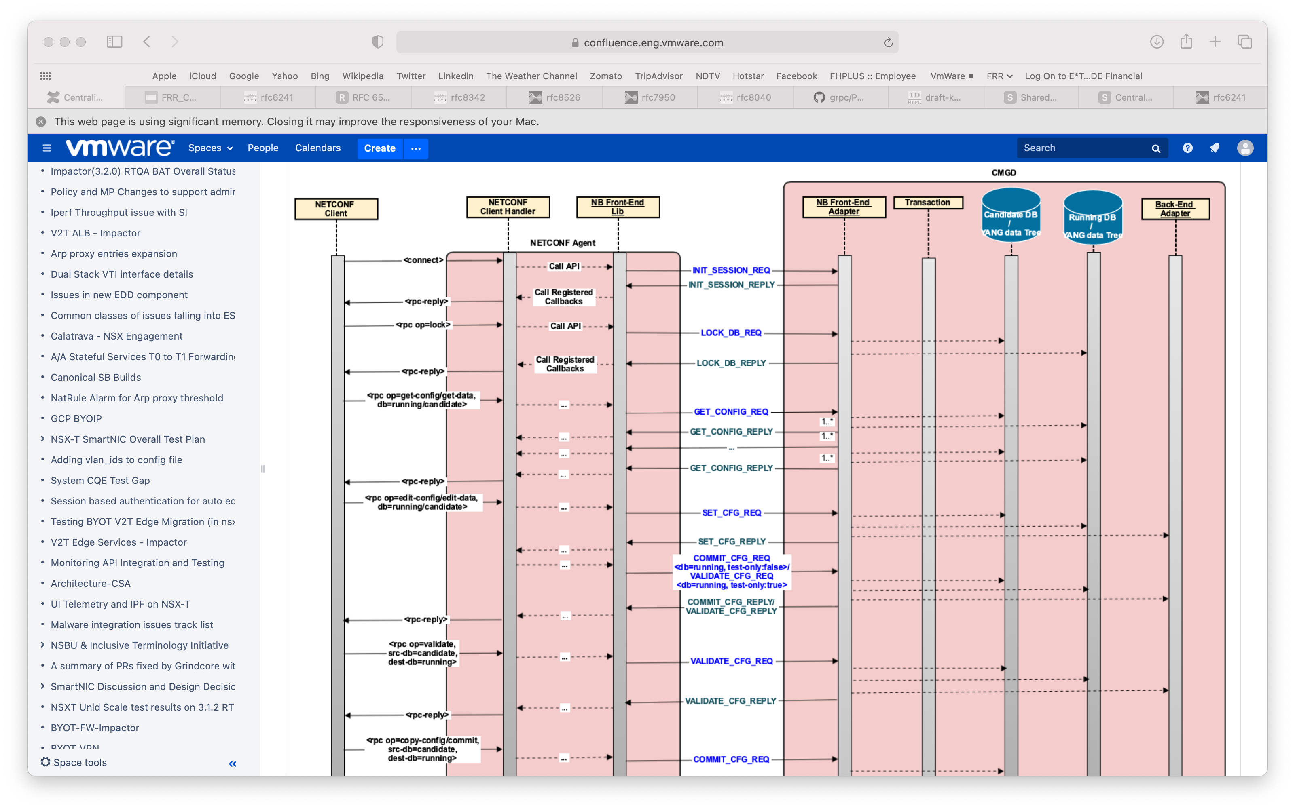
Front-End Interface
NETCONF Client
<lock>
LOCK_DB_REQ/REPLY
<get-config/get-data> for ‘running’ or ‘candidate’ DB.
GET_CONFIG_REQ/REPLY
<edit-config>/<edit-data>
SET_CONFIG_REQ/REPLY
VALIDATE_CONFIG_REQ/REPLY for ‘running’ DB and ‘test-only:true’.
COMMIT_CONFIG_REQ/REPLY for ‘running’ DB and ‘test-only:false’.
<validate>
VALIDATE_CONFIG_REQ/REPLY

Slide 23
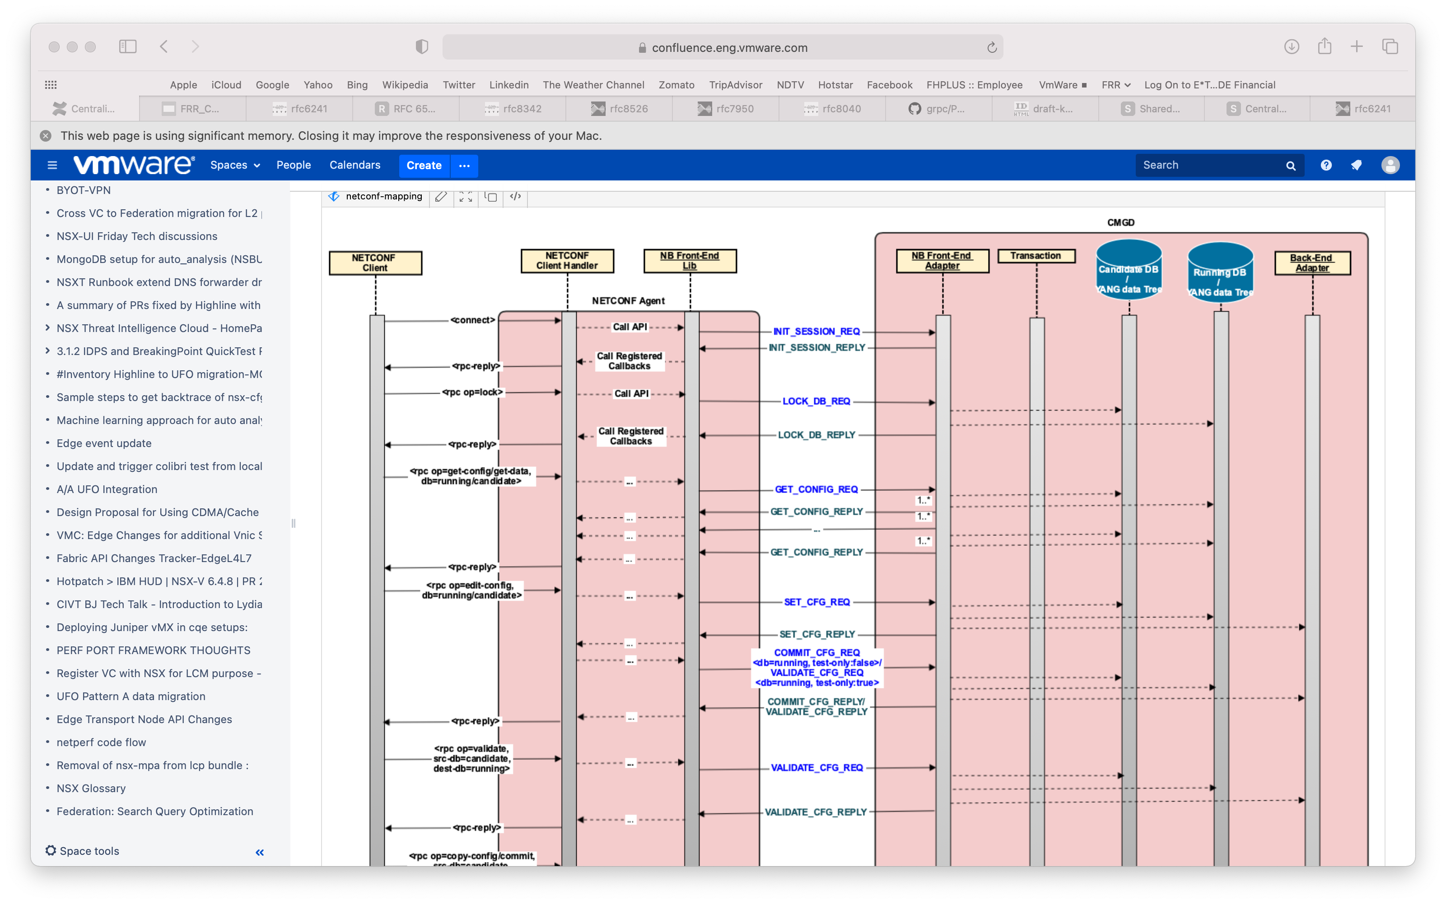
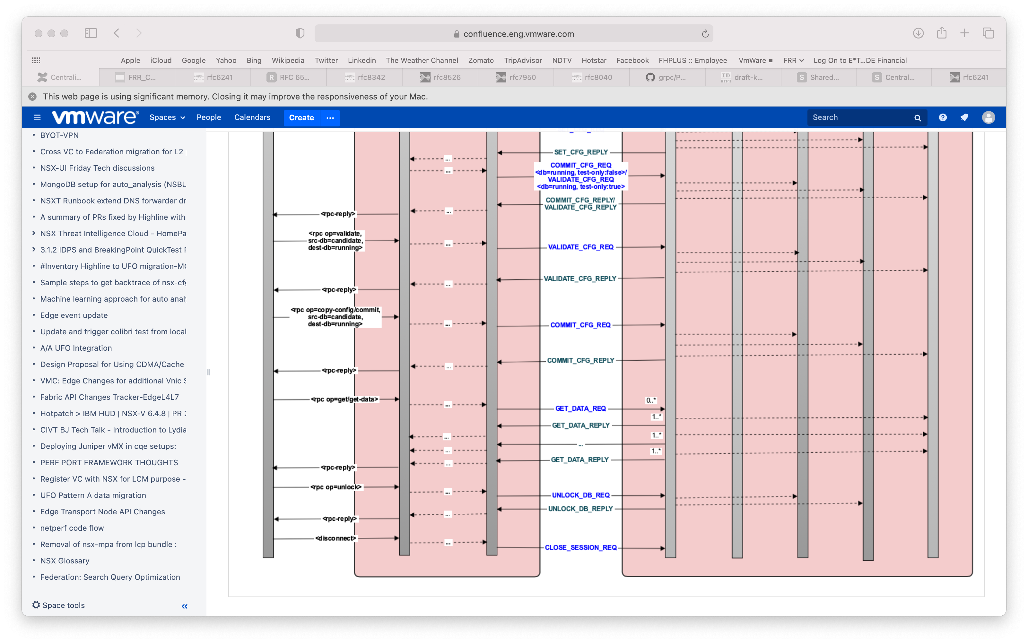
Front-End Interface
NETCONF Client (contd.)
<copy-config>/<commit>
COMMIT_CONFIG_REQ/REPLY.
<get-data>/<get> for ‘operational’ DB.
GET_DATA_REQ/REPLY
<unlock>
UNLOCK_DB_REQ/REPLY

Slide 24
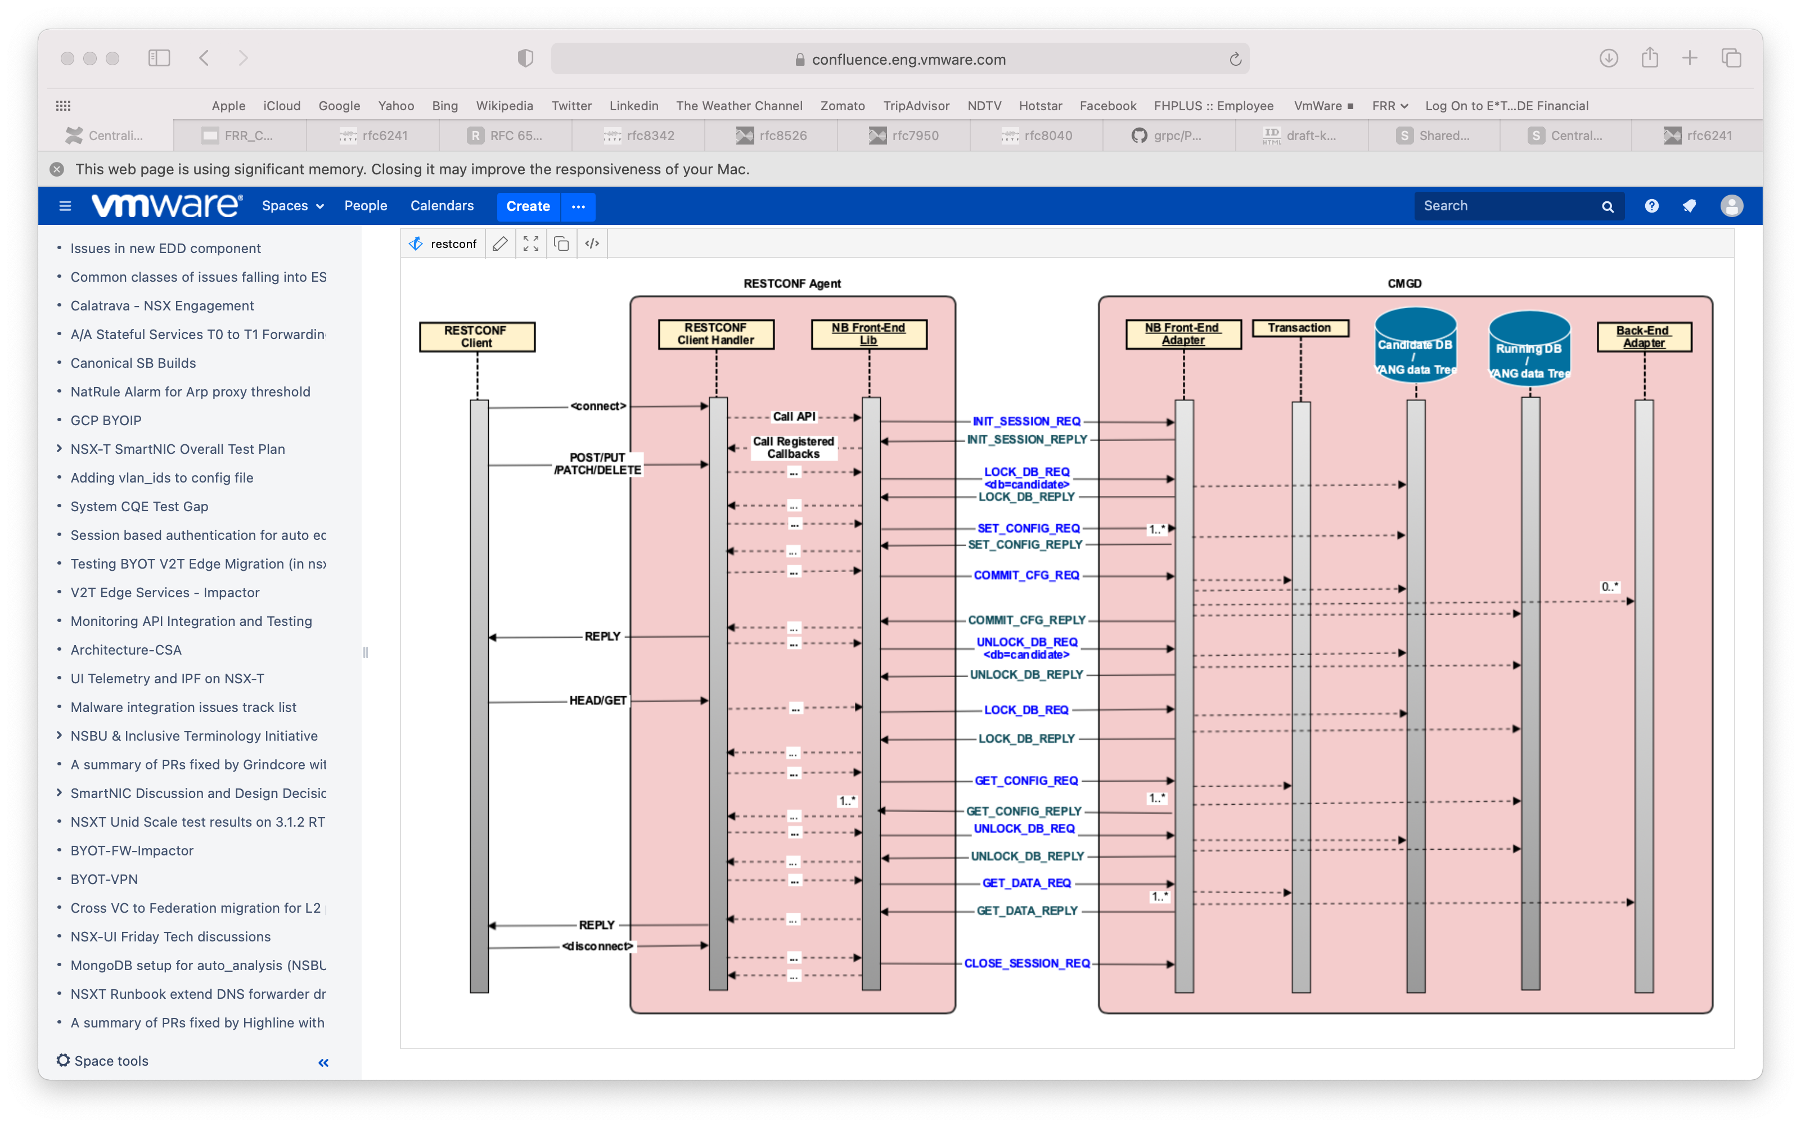
Front-End Interface
RESTCONF Client
POST/PUT/PATCH/DELETE
LOCK_DB_REQ/REPLY
SET_CONFIG_REQ/REPLY
COMMIT_CONFIG_REQ/REPLY
UNLOCK_DB_REQ/REPLY
HEAD/GET
LOCK_DB_REQ/REPLY
GET_CONFIG_REQ/REPLY
UNLOCK_DB_REQ/REPLY
GET_DATA_REQ/REPLY

Slide 25
Back-End Interface

Slide 26
Backend-End Interface
CMGD Back-End Adapter Message-API
Back-End Registration
CLIENT_SUBSCRIBE_REQ <Req-Id, Base-Yang-Xpath, Filter-Type>
CLIENT_SUBSCRIBE_REPLY <Req-Id, Status>
Transaction Management
CREATE_TRXN_REQ <Trxn-Id, Create> with ‘Create’=False for Delete request
CREATE_TRXN_REPLY <Trxn-Id, Create, Status>
Notifications
DATA_NOTIFY_REQ <Xpath, DataContents>

Slide 27
Backend-End Interface
CMGD Back-End Adapter Message-API
Configuration
CREATE_CFGDATA_REQ <Trxn-Id, Req-Id, Batch-Id, ConfigDataContents>
CREATE_CFGDATA_ ERROR <Trxn-Id, Req-Id, Batch-Id, Status>
VALIDATE_CFGDATA_REQ <Trxn-Id, Req-Id, Batch-Id>
VALIDATE_CFGDATA_REPLY <Trxn-Id, Batch-Id, Status, ErrorInfo>
APPLY_CFGDATA_REQ <Trxn-Id, Batch-Id>
APPLY_CFGDATA_REPLY <Trxn-Id, Batch-Id, Status, ErrorInfo>
Retrieving Opertional Data
GET_OPERDATA_REQ <Trxn-Id, Req-Id, Base-Yang-Xpath, Filter-Type>
GET_OPERDATA_REPLY <Trxn-Id, Req-Id, OperDataContents>
Invoke RPC/Action
ACTION_REQ < Trxn-Id, Req-Id, Yang-Xpath>
ACTION_REPLY < Trxn-Id, Req-Id, Status, ErrorIfAny>

Slide 28
Transaction Management

Slide 29
Transaction Management
Low-level Design details
Requirements
Only one configuration ‘commit’ allowed at any point in time.
But one configuration ‘commit’ and several ‘show’ commands from multiple sessions MAY be allowed.
Assumptions
Multiple users may enter config mode and enter config commands.
But only the transaction for which ‘commit’ is received first will be put ‘In-Progress’.
All ‘commits’ from that point will be responded back with failure till the current ‘In-progress’ commit is finished and the ‘Running DB’ is updated.

Slide 30
Transaction Management
Handling Multiple User Sessions: OPTION1
User 1
$ config terminal
# vrf red
# Ip route 1.1.1.1/32 ens192
# show config
vrf red
Ip router 1.1.1.1/32 ens192
# commit
<commit successful>
#
User 2
$
$ config terminal
# vrf red
# Ip route 1.1.1.1/32 ens224
# show config
vrf red
Ip router 1.1.1.1/32 ens224
# commit
< error – commit already in-progress >
# do show running-config vrf red
vrf red
Ip router 1.1.1.1/32 ens192
# commit
<commit successful>
#
User 3
$ show running-config vrf red
<blank>
$ show running-config vrf red
<blank>
$ show running-config vrf red
<blank>
$ show running-config vrf red
<blank>
$ show running-config vrf red
<blank>
$ show running-config vrf red
vrf red
Ip router 1.1.1.1/32 ens192
$
$ show running-config vrf red
vrf red
Ip router 1.1.1.1/32 ens224

Slide 31
Transaction Management
Handling Multiple User Sessions: OPTION2 <Preferred so far>
User 1
$ config terminal
# vrf red
# Ip route 1.1.1.1/32 ens192
# show config
vrf red
Ip router 1.1.1.1/32 ens192
# commit
<commit successful>
# end
$
User 2
$
$ config terminal
< error – config session already in-progress >
$ config terminal
< error – config session already in-progress >
$ config terminal
< error – config session already in-progress >
$ config terminal
< error – config session already in-progress >
…
$ config terminal
# vrf red
# ip route 1.1.1.1/32 ens224
#commit
<commit successful>
#
User 3
$ show running-config vrf red
<blank>
$ show running-config vrf red
<blank>
$ show running-config vrf red
<blank>
$ show running-config vrf red
<blank>
$ show running-config vrf red
<blank>
$ show running-config vrf red
vrf red
Ip router 1.1.1.1/32 ens192
$
$ show running-config vrf red
vrf red
Ip router 1.1.1.1/32 ens224

Slide 32
Transaction Management
Types of Transactions
CONFIG – Configuration Transactions
Write (and possibly read) transactions.
Initiated with a ‘commit’ command.
Only one allowed at any point in time.
Takes a write-lock on the System-wide Running DB
Only when merging the candidate DB with running DB -- ???.
SHOW – Show Oper/Config Transactions
Read-only transactions.
Initiated with a ‘show’ command.
Multiple parallel ‘show’ transaction may be allowed.
Takes a read-lock on the System-wide Running DB.
Cannot proceed while ‘merging of the candidate DB with running DB’ from a parallel CONFIG transaction.

Slide 33
End-to-End Processing

Slide 34
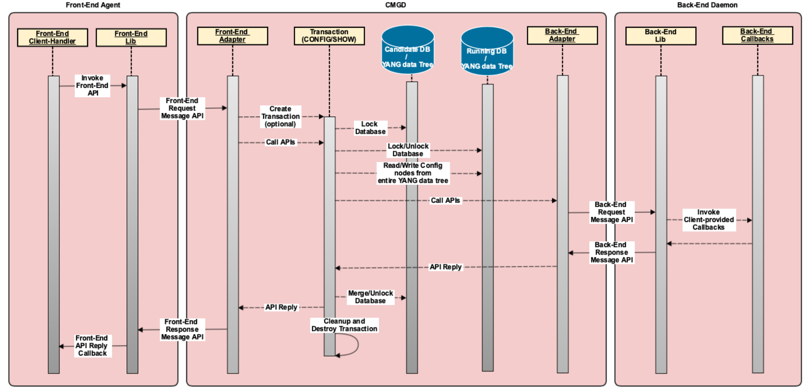
High-level End-to-End Processing Flow

Slide 35
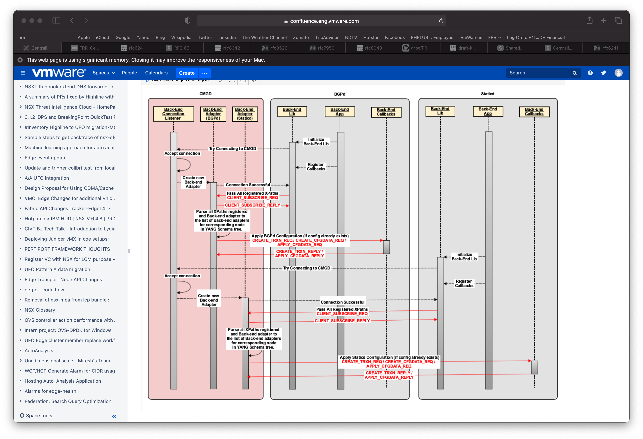
Back-end Initialization and Registration
(Re)Connecting to CMGD
Back-end daemon re/init
Initializes NB back-end library
Provides unique details identifying itself uniquely.
Triggers connection initiation towards CMGD.
Registers required callbacks for the YANG models it is interested in.
Registers a series of callback handlers for individual/group of configuration and operational data items.
NB back-end lib passes the same to CMGD.
CMGD
Creates new Back-end adapter.
Associates it with relevant parts of the YANG data tree.
Passes any relevant configuration already present.

Slide 36
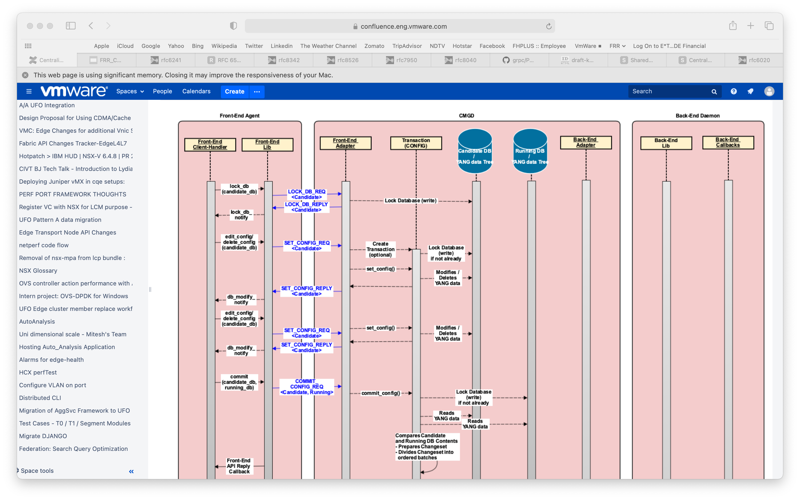
Processing Configuration using Transactions
Locking Candidate Database and Editing Configuration
CMGD receives LOCK_DEB_REQ for candidate DB.
Creates transaction for entire processing
Examines the changeset and prepares.
Candidate DB andl ist of YANG tree nodes being changed.
List of back-end adapters associated.
Ordered batches of config nodes with associated back-end adapter(s)
Sends indication to each back-end daemon for creating local transaction context.
Sends each batch of config items to corresponding back-end daemons for verification/validation.
On successful validation from all
Pushes the same batches of config items to the relevant back-end daemon(s) for final apply.
Replies back to Front-end adapter with success
Merges candidate DB to running DB.
Cleans up and deletes the transaction itself.

Slide 37
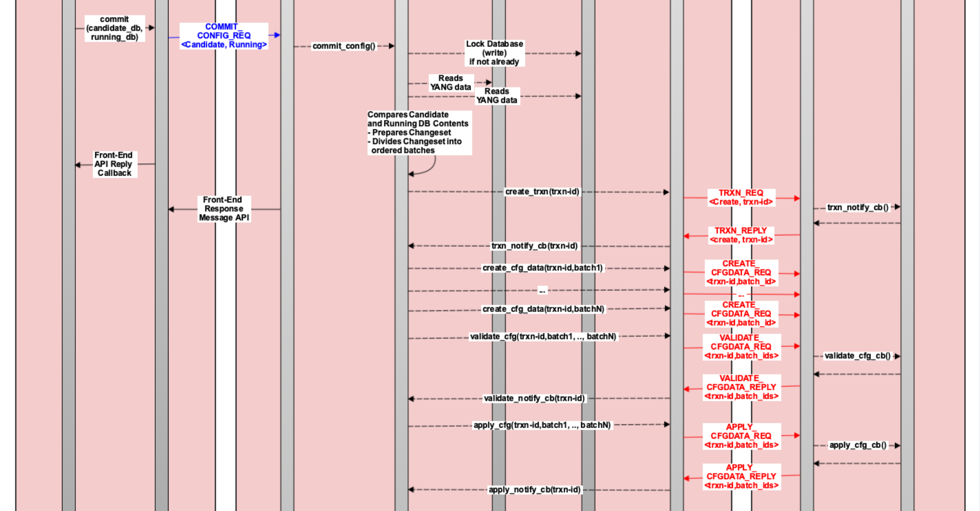
Processing Configuration using Transactions
Commit Configuration from Candidate to Running DB
CMGD receives commit request.
Creates transaction for entire processing
Examines the changeset and prepares.
Candidate DB andl ist of YANG tree nodes being changed.
List of back-end adapters associated.
Ordered batches of config nodes with associated back-end adapter(s)
Sends indication to each back-end daemon for creating local transaction context.
Sends each batch of config items to corresponding back-end daemons for verification/validation.
On successful validation from all
Pushes the same batches of config items to the relevant back-end daemon(s) for final apply.
Replies back to Front-end adapter with success
Merges candidate DB to running DB.
Cleans up and deletes the transaction itself.

Slide 38
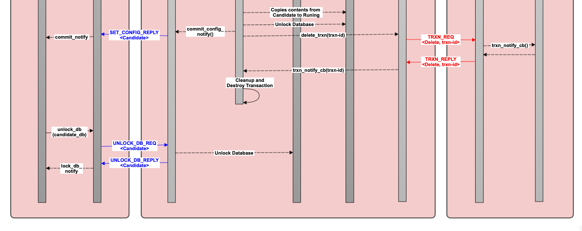
Processing Configuration using Transactions
Cleaning up commit and Unlocking the Candidate DB
CMGD receives commit request.
Creates transaction for entire processing
Examines the changeset and prepares.
Candidate DB andl ist of YANG tree nodes being changed.
List of back-end adapters associated.
Ordered batches of config nodes with associated back-end adapter(s)
Sends indication to each back-end daemon for creating local transaction context.
Sends each batch of config items to corresponding back-end daemons for verification/validation.
On successful validation from all
Pushes the same batches of config items to the relevant back-end daemon(s) for final apply.
Replies back to Front-end adapter with success
Merges candidate DB to running DB.
Cleans up and deletes the transaction itself.

Slide 39
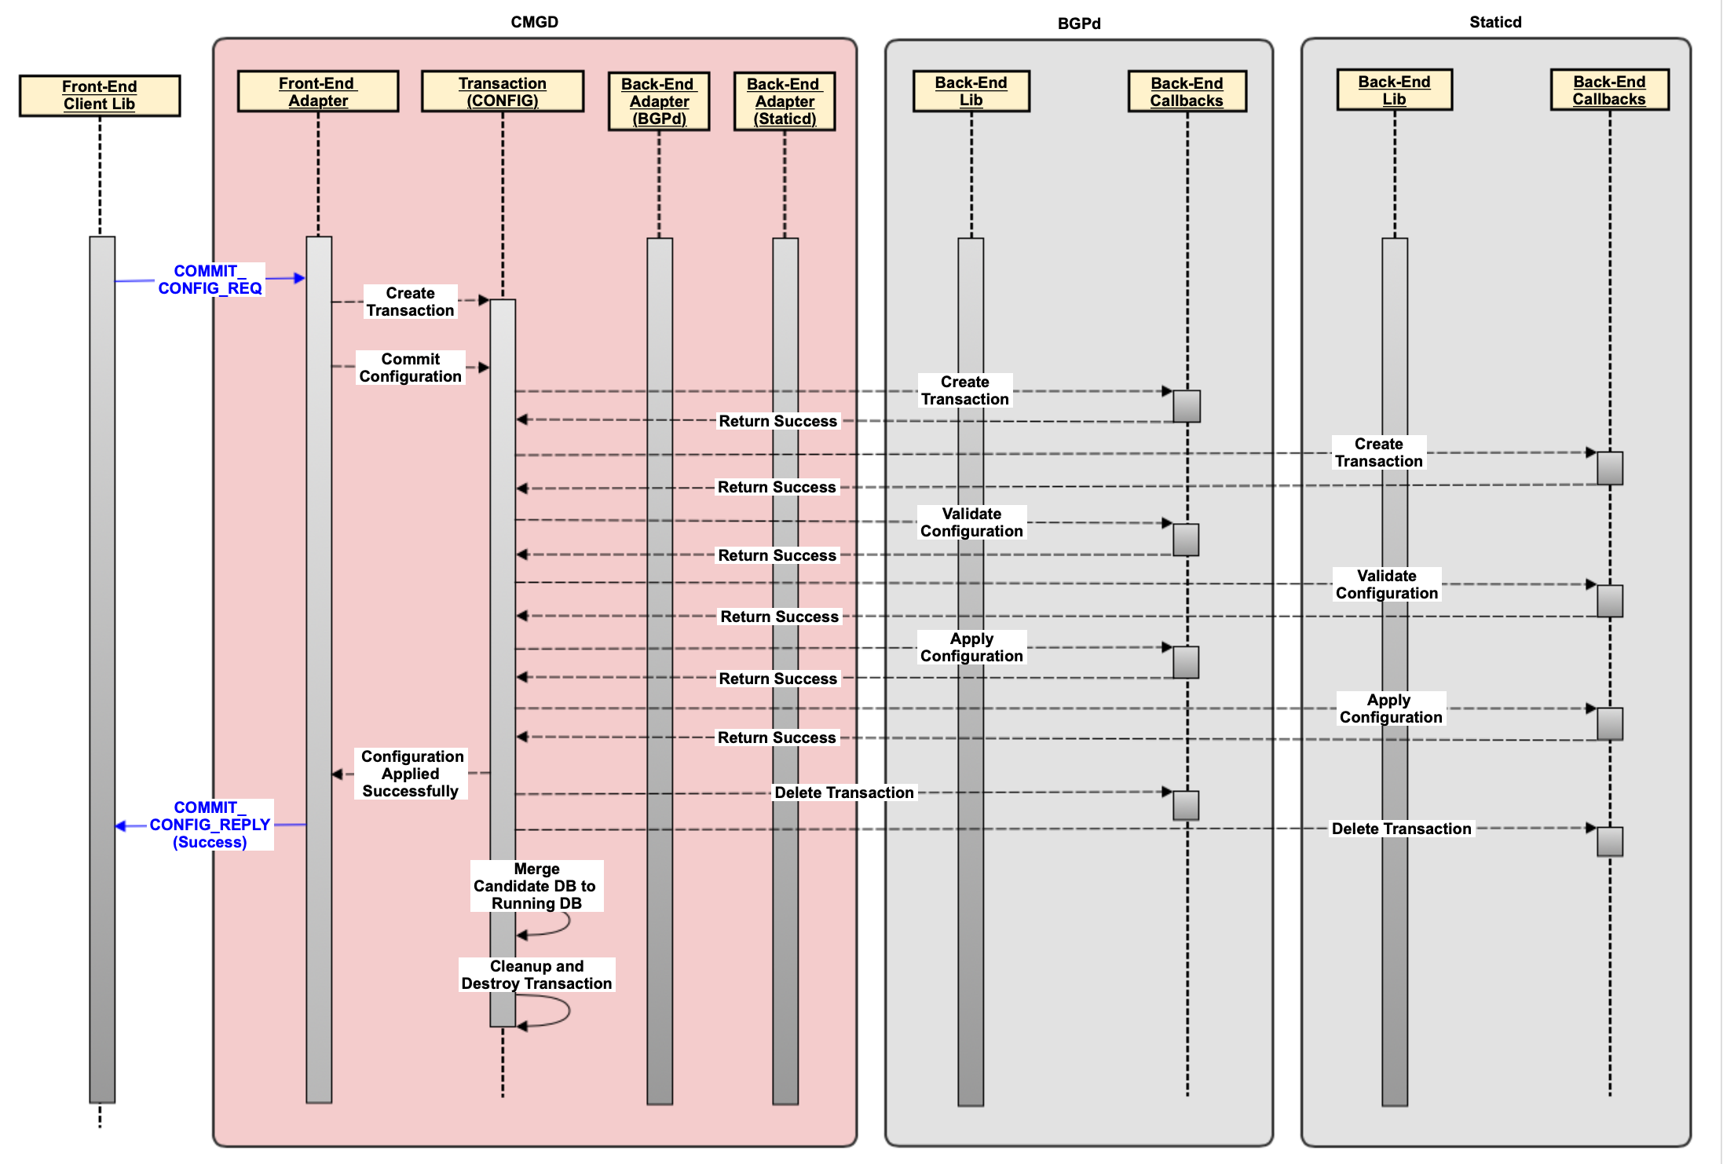
Processing Configuration using Transactions
Handling Valid Configurations across multiple Backend Daemons
CMGD receives commit request.
Creates transaction for entire processing
Examines the changeset and prepares.
Candidate DB andl ist of YANG tree nodes being changed.
List of back-end adapters associated.
Ordered batches of config nodes with associated back-end adapter(s)
Sends indication to each back-end daemon for creating local transaction context.
Sends each batch of config items to corresponding back-end daemons for verification/validation.
On successful validation from all
Pushes the same batches of config items to the relevant back-end daemon(s) for final apply.
Replies back to Front-end adapter with success
Merges candidate DB to running DB.
Cleans up and deletes the transaction itself.

Slide 40
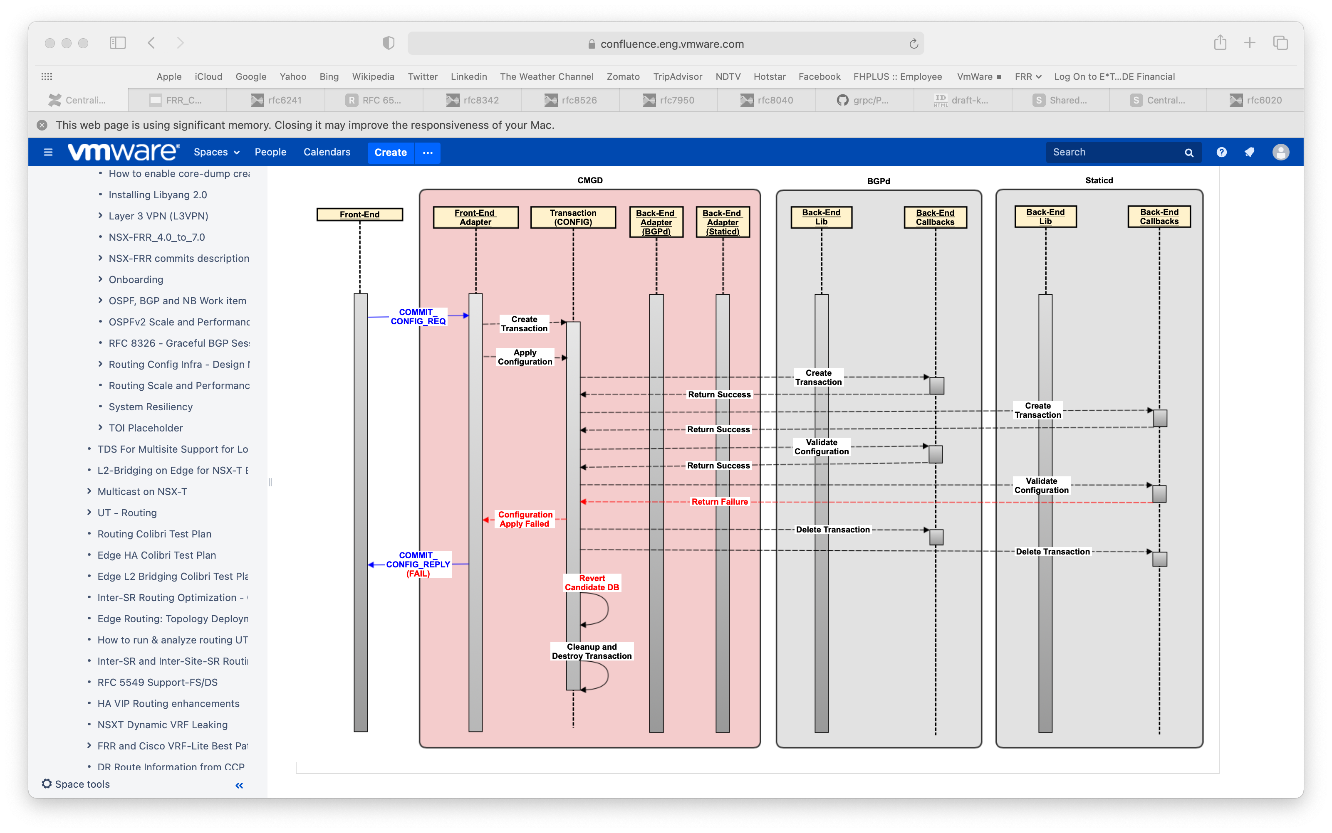
Processing Configuration using Transactions
Handling Invalid Configurations across multiple Backend Daemons
CMGD receives commit request.
Creates transaction thread for entire processing
Examines the changeset and prepares.
Candidate DB andl ist of YANG tree nodes being changed.
List of back-end adapters associated.
Ordered batches of config nodes with associated back-end adapter(s)
Sends indication to each back-end daemon for creating local transaction context.
Sends each batch of config items to corresponding back-end daemons for verification/validation.
On first validation failure from any
Replies back to Front-end adapter with error.
Deletes candidate DB.
Cleans up and deletes the transaction thread itself.

Slide 41
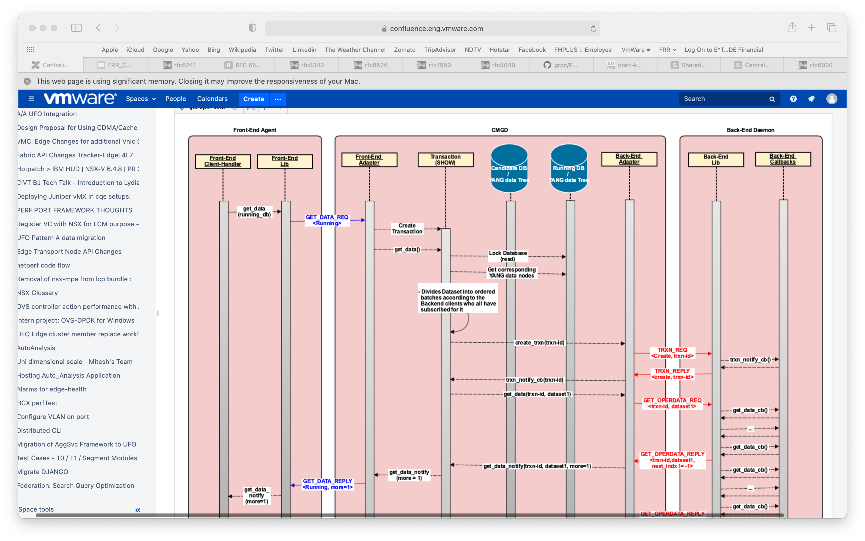
Retrieve Operational Data
Retrieve Lists, Containers and Leaf members

Slide 42
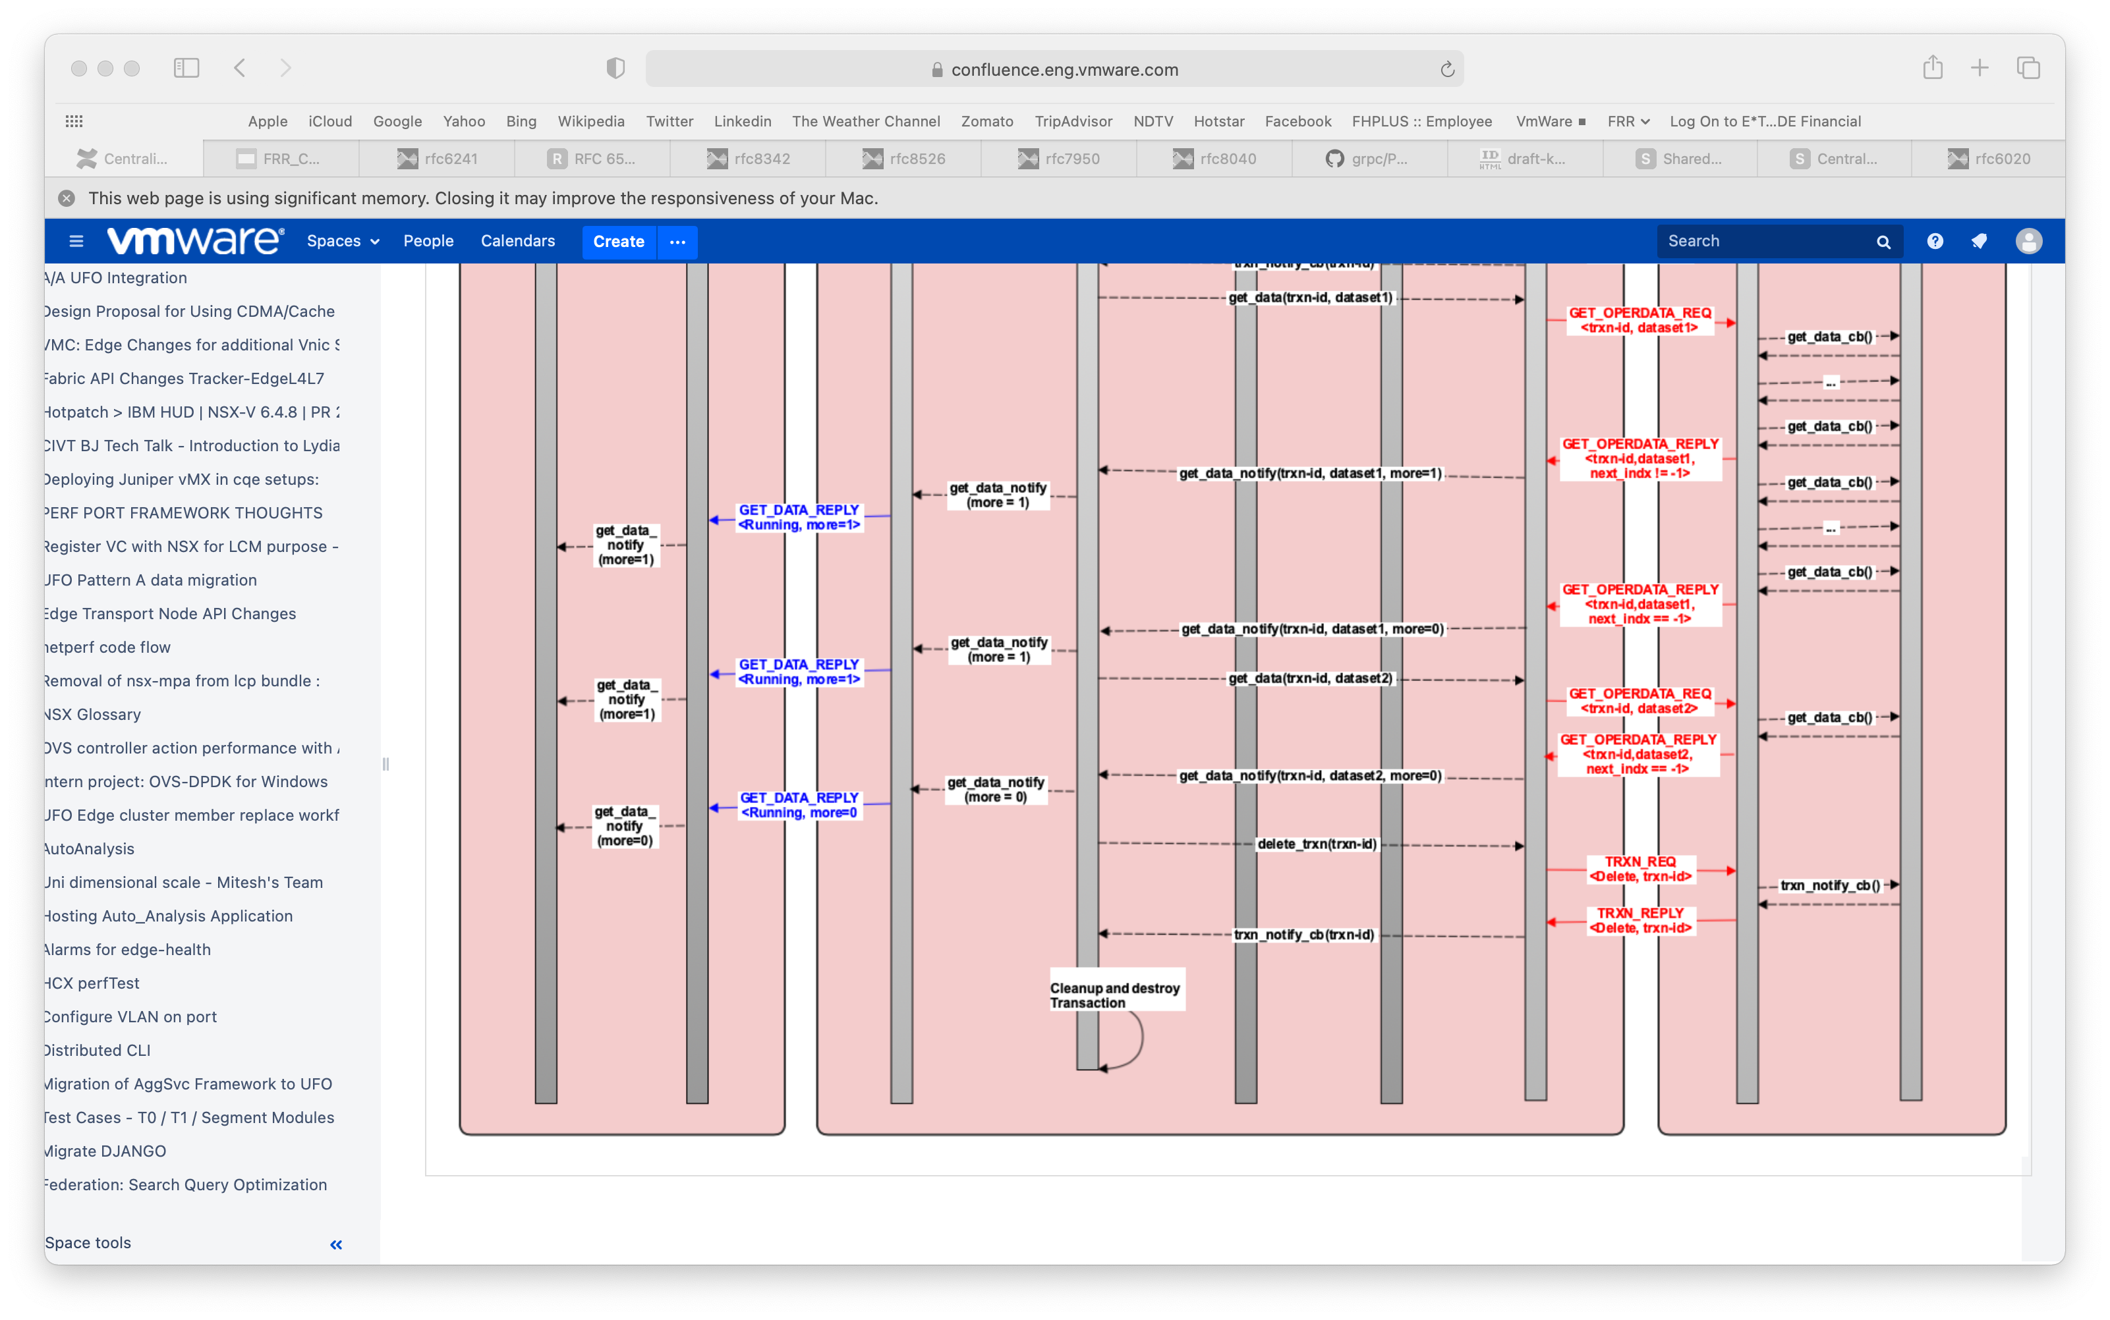
Retrieve Operational Data
Retrieve Lists, Containers and Leaf members

Slide 43
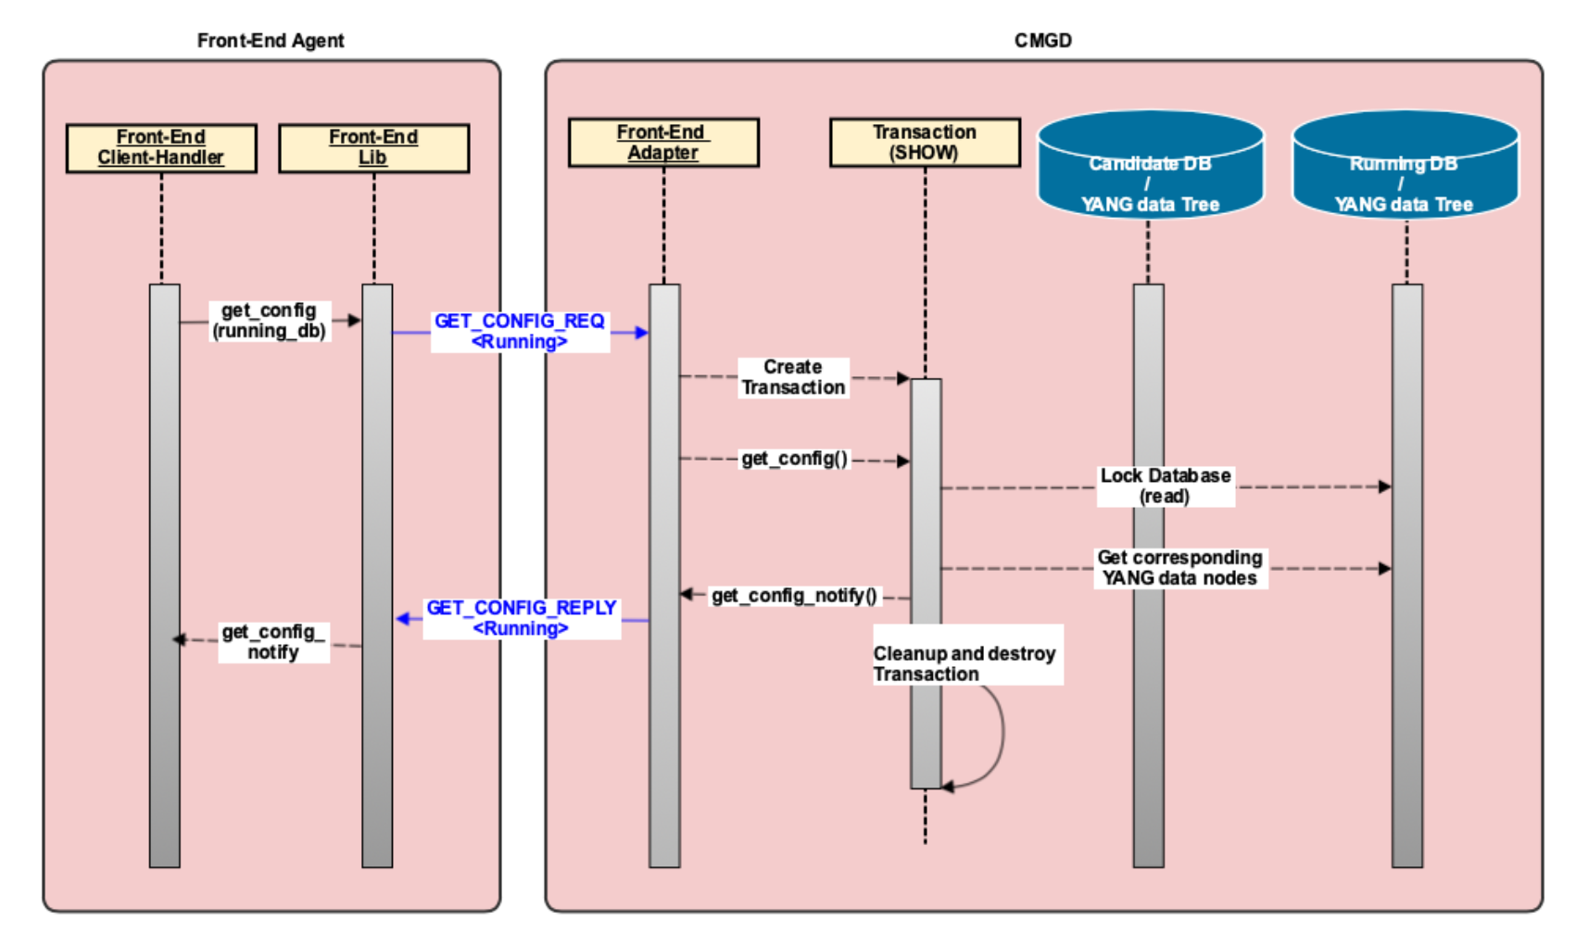
Retrieving ‘show running-config’
Running DB maintained on CMGD.
Configurations already verified and applied earlier on back-end daemons.
No need to involve back-end process for ‘show running config’.

Slide 44
Parsing YANG XPath

Slide 45
Parsing YANG XPath
XPATH:
/frr-routing:routing/control-plane-protocols/control-plane-protocol{frr-rt:type='frr-bgp:bgp', name='bgp-100', frr-vrf:vrf='default'}/frr-bgp:bgp/global/frr-rt:router-id
<Notes TBA>
length = 7 | num_keys | keys[0] | keys[1] | keys[2] | … | keys[255]
tags[0] | 1 | routing
tags[1] | 1 | control-plane-protocols
tags[2] | 1 | control-plane-protocol
tags[3] | 3 | type = “bgp” | name = ”bgp-100" | Vrf = ”default”
tags[4] | 1 | bgp
tags[5] | 1 | global
tags[6] | 1 | router-id = ”1.1.1.1"
…
Tags[255]

Slide 46
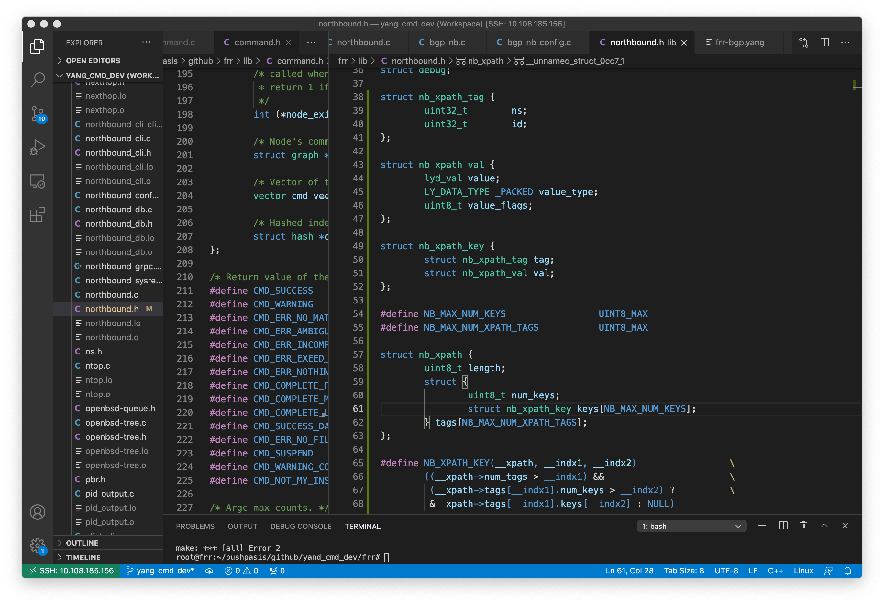
Parsing YANG XPath
<Notes TBA>

Slide 47
Parsing YANG XPath
 | num_keys | keys[0] | keys[1] | keys[2] | … | keys[255]
tags[0] | 1 | .tag = { .ns = frr-routing, .id = routing } .val = { .xml_tag = "routing" }
…
tags[3] | 3 | .tag = { .ns = frr-rt, .id = type } .val = { .identityref = ”bgp" } | .tag = { .ns = frr-rt, .id = name } .val = { .string = ”bgp-100" } | .tag = { .ns = frr-vrf, .id = vrf } .val = { .string = ”default” }
…
tags[6] | 1 | tag = { .ns = frr-rt, .id = router-id } .val = { .ipv4_addr = ”1.1.1.1" }

Slide 48
Open Items and Issues
Items
Support for namespace
Registration of callbacks at back-end. Possibly from multiple back-end daemons for the same configuration item with priority-based ordering.
Delivery of callbacks registered from multiple backends for the same configuration item
Avoid YANG parsing on back-end process.
Provide all the keys of YANG XPath to back-end callback handlers.
Issues
Re-use of existing NB callback handlers.
Avoid duplicating YANG data tree across CMGD and back-end daemons.

Slide 49
Next Items
Low-level Designs
Support for namespace
Registration of callbacks at back-end. Possibly from multiple back-end daemons for the same configuration item with priority-based ordering.
Delivery of callbacks registered from multiple backends for the same configuration item
Avoid YANG parsing on back-end process.
Provide all the keys of YANG XPath to back-end callback handlers.
Issues
Re-use of existing NB callback handlers.
Avoid duplicating YANG data tree across CMGD and back-end daemons.

Slide 50
References
Northbound Architecture Wiki: https://github.com/opensourcerouting/frr/wiki/Architecture
Requirements for Centralised Management: https://github.com/FRRouting/frr/wiki/FRR-Centralized-Management-Requirements

Slide 51
THANK YOU!!!

